Slide 1
Boostrapping Devops in the large Enterprise
Tales from the Front Line
@Kathryn_e_Kuhn
http://www.linkedin.com/in/kathrynekuhn/
Notes:
problem - 2015 (I hope) becomes the year at enterprises who have started down their agile transformation paths realize that they have stalled. Really stalled.
why the problem is a problem - there have been some benefits, but the real transformation that leads to greater profits, happier employees and truly better products hasn’t happened. We have just gotten more efficient at delivering the wrong thing.
my startling sentence - In order to get past the stall we have to look outside of traditional agile knowledge repositories for inspiration and clues on how to break some of the common patterns

Slide 2


Our product and our problem
www.forj.io
@forjio
http://www.ticatoca.com/products/409d856d22cffe3e394cf48e3c8115ab.jpg

Slide 3





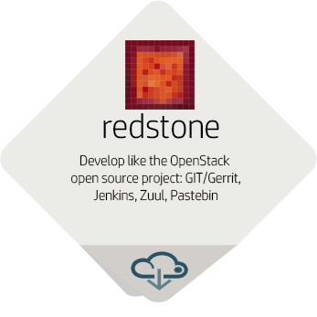
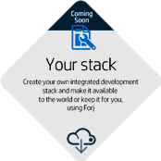

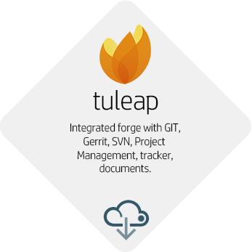



Forj: ready made CI/CD pipelines by HP Helion
Choose a Continuous Integration / Delivery stack
Develop, test, review, merge, promote
Deploy and operate on HP Helion PaaS or IaaS
Deploy
Feedback Loop
Community
Code
Continuous Delivery
Test
Build
My Application
Continuous Integration
Notes:
From HP Helion / Horizon console, a team chooses a blueprint (Continuous Integration / Delivery stack) to develop and release its application or service (see below for details on blueprints)
The forge – instantiation of the blueprint - is made available together with an HP Helion “Project” (tenant).
The customer can setup and manage as many forges as needed. One is usually needed.
The forge provides backup/restore, monitoring and other core services for the forge and its data
Blueprints
Certain blueprints can be supported by HP. This is clearly indicated at the time of choosing the blueprint.
HP can partner with third parties to add support for additional blueprints (example: Tuleap, which could be supported by Enalean)
Blueprints provide the choice. Blueprints are either Open Source or Closed Source. They can be include Open Source tools, HP products (see below), 3rd party products, and can leverage SaaS.
Blueprints can be limited to Continuous Integration, or can go up to Continuous Delivery by providing capabilities to support deployment (integration with IaaS or PaaS), monitoring, and other continuous delivery pipeline mechanisms.
Examples of HP value add options which can be added over time:
HP Fortify for static code analysis against known security flaws (Saas or deployed with the forge)
HP Performance Testing as a Service for performance testing during testing or before production promotion (SaaS)
HP Unified Functional Tester and HP Service Virtualization for automated GUI and API regression testing with 3rd party services emulation. This resource is elastic and takes advantage of the cloud.
HP ALM for requirement management, defect tracking and test management (SaaS or deployed with the forge)
HP Agile Manager for Agile / backlog management (SaaS or deployed with the forge)
HP Operations Orchestrations as deployment technology
HP Pulse for application monitoring and integration with Agile backlog management (performances issues automatically logged as defects)
HP BSM for application / system monitoring
HP Service Anywhere for ticketing
HP Arcsight for log analysis against attack / security threats patterns
Example use cases for Helion Dev as a Service:
Develop like the OpenStack project in less than 1h
Offer CI/CD capabilities on demand, within your enterprise
Start developing with a continuous integration stack in less than 1h, behind your firewall
NFV: create NFV services & functions with a ready to use DevOps platform (preferably PaaS as target) – fully realizing the promise of NFV
Create CI/CD stacks which you leverage for your customer projects (Service companies, HP ES use case)
Use private or public cloud to scale continuous integration dynamically (Cloud for R&D)
Share a forge (development processes and tools) with your partners or customers, without sharing the infrastructure (a given forge can be duplicated at will)
Training & Education: run software development labs without worrying on standing up / maintaining infrastructure
Stand up a full end to end environment to develop and make available NFV, SDN, HAVEn (big data) applications & services
HP Internal (through PDE IT):
HP R&D: Nimble product development, testing and delivery by providing ready-made CI/CD stacks with a supported product platform
HP ES: take advantage of existing and evolving ES Service Platform initiative to bring the first customers
HP IT: Increase velocity and quality by leveraging true cloud capabilities and embracing at least Continuous Integration and DevOps where possible
HP IT: enable the move to PaaS and DevOps, by integrating existing enterprise gates, tools and processes in a blueprint

Slide 4


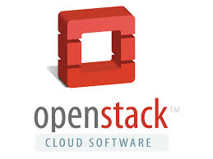
The challenge
An embarrassment of riches…

Slide 5
Culture eats process for lunch

Slide 6


More “Adam/Jamie” and less “Sheldon”

Slide 7
Dare to under resource

Slide 8

Optimize for Similar Timezones
Notes:
We greatly reduced the range of timzones. We knowingly didn’t pick the BEST resource for ever task. Invested in Mexico to limit the timezones of the dev team. Tough on our manager. Find that we actually can manage all our timezones with Europe and palo alto. Even that requires CA to get up early and Europe to work late. But it’s better than waiting 24 hours for every communication.
There are talented people in asia. Not what I’m saying. If your group hasa center of gravity in eastern Europe then add Asia OR western US, but not both.

Slide 9
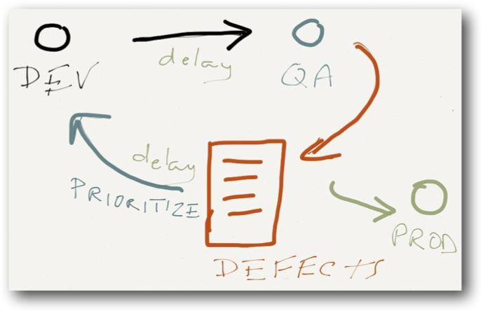
No separate QA…or OPS team
Notes:
Developers design their code to be testable from the beginning
We see more experimentation with testing tools
Treat test automation like code – it goes in scm tool, back it up, it has coding standards
We actually have fewer defects and not because developers don’t test – because the defects can found and fixed during the coding process
Defect ownership gets shockingly easy = no more hunting to assign someone

Slide 10
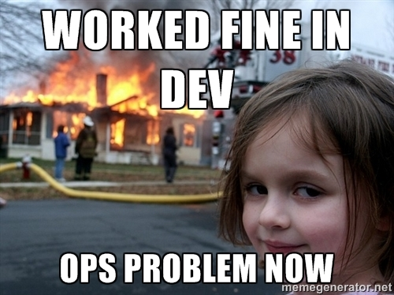
Don’t make the *-ilities someone else’s problem
Notes:
We do our own global cyber security review – didn’t pass it to a project manager
Same with privacy, data retention – we examined this ourselves
Even doing our own marketing and training collateral
We are even doing our own support- feel production and customer issues first hand

Slide 11
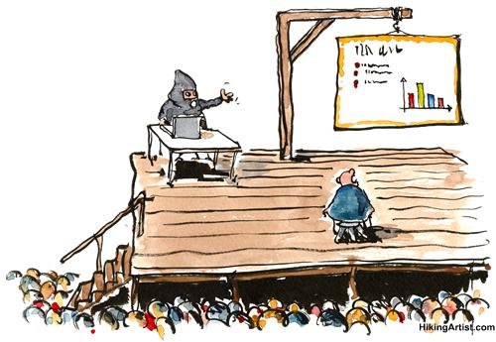
The Best Tool is the one the team actually uses
Groupzap
Pastebin
MediaWiki
Etherpad

Slide 12
Make all work visible
Notes:
Mention Jeff Sutherland on book tour reminded me how important this is

Slide 13
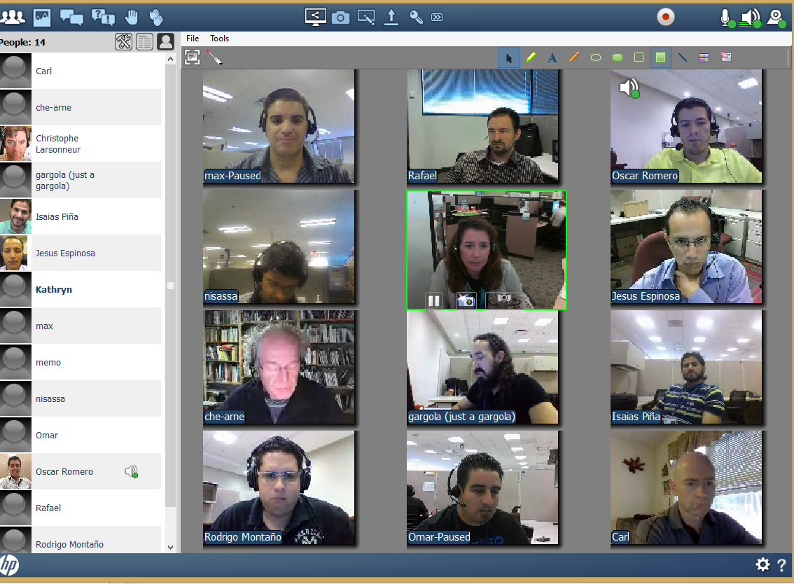
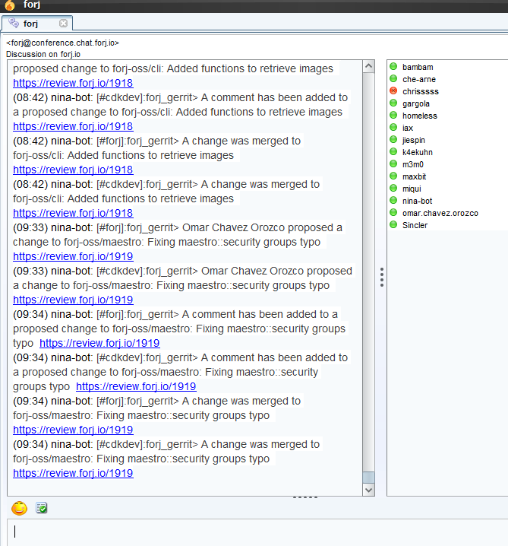
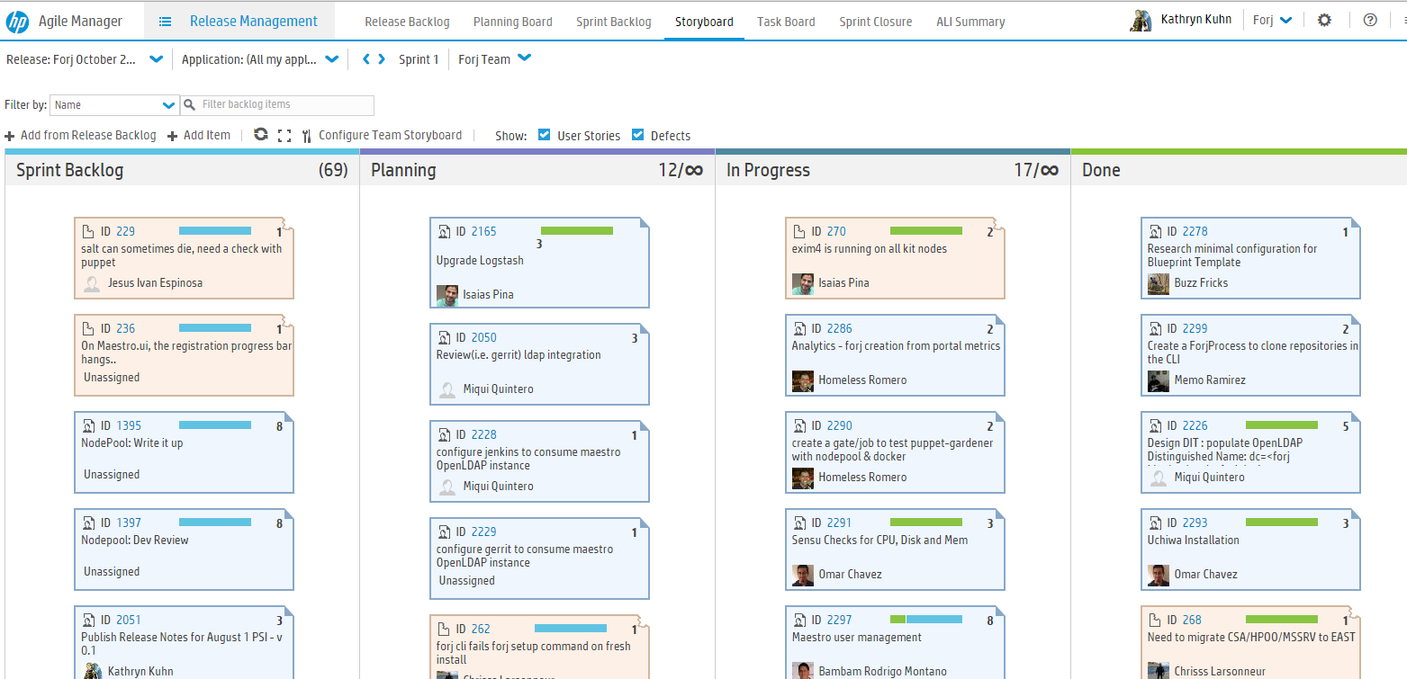

Slide 14
Working code über alles

Slide 15
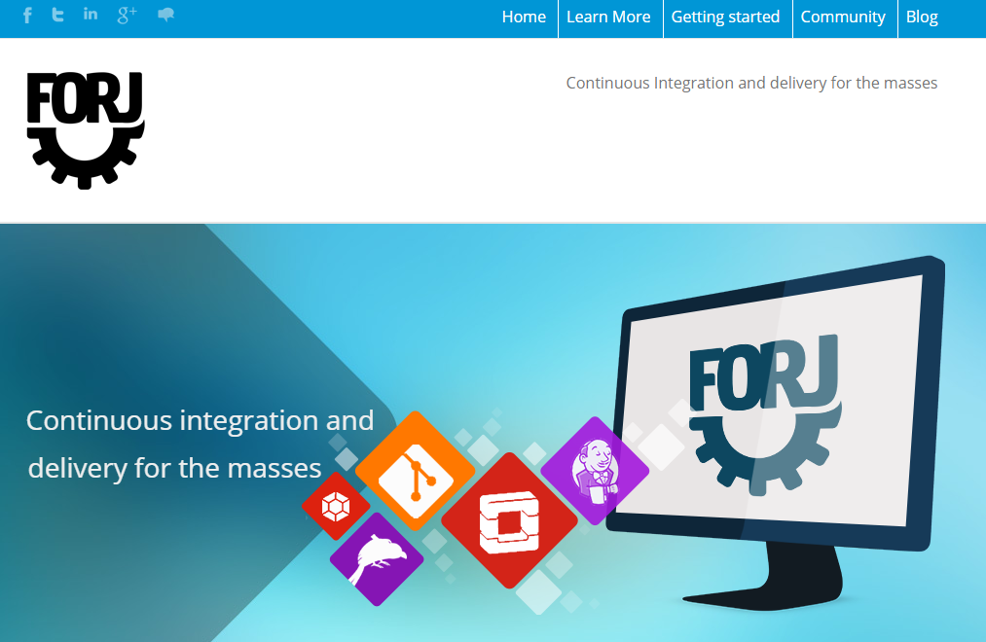
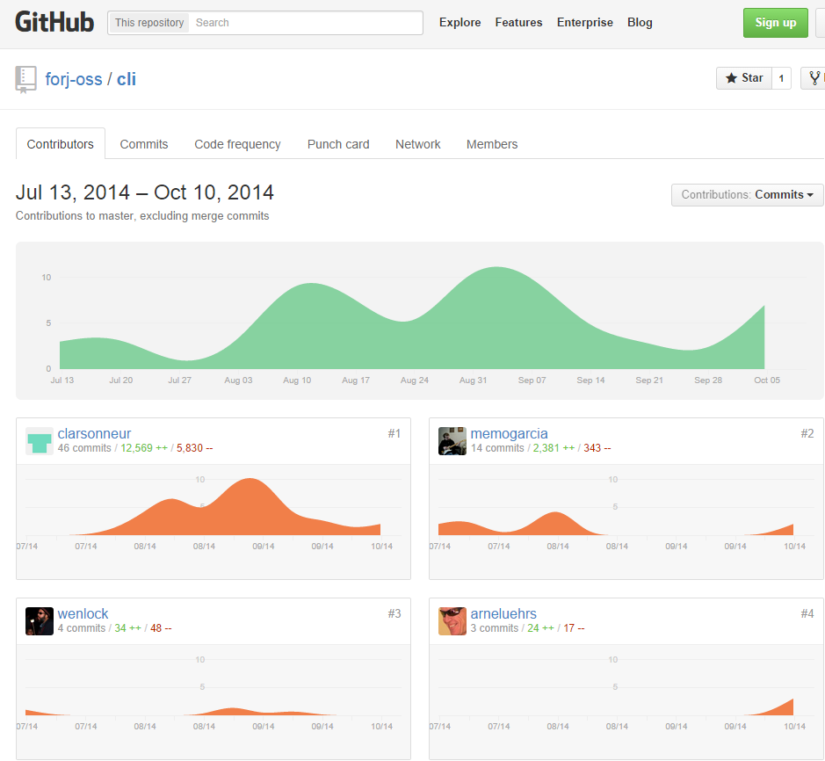
Went from idea to working end to end prototype in 4 weeks
Idea to executive demo in 6 weeks
Idea to Live Demo on main floor of our largest User Forum in less than 4 months

Slide 16
Architect for experimentation first, performance and scalability second

Slide 17


Rails vs node.js
Nagios vs ELK, Sensu/Uchiwa
Rspec, Sinatra, Docker, Rabbit MQ, Redis

Slide 18
Sometimes you need to lead with culture and values to make the biggest impact
The Big Idea

Slide 19
Thank you
@Kathryn_e_Kuhn
http://www.linkedin.com/in/kathrynekuhn/

Slide 20
Please Help me with designing “devops training”

